Slide 1
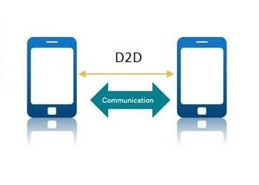
DEVICE DISCOVERY IN D2D COMMUNICATION
PROJECT GUIDE :
Mr. Devarajsamy. S,ME.,
(Assistant professor /IT )
TEAM MEMBERS :
Boopalan G
Giri S
Sakthivel Murugan S
Yogesh E

Slide 2
ABSTRACT
Device-to-Device (D2D) correspondence in cell networks is characterized as immediate correspondence between two versatile clients without navigating the Base Station (BS) or center organization.
D2D correspondence is by and large non-straightforward to the cell organization and it can happen on the cell frequencies (i.e., in band) or unlicensed range (i.e., outband).
In a conventional cell organization, all interchanges should go through the BS regardless of whether conveying parties are in range for vicinity based D2D correspondence.
Correspondence voice call and text informing in which clients are only occasionally close enough for direct correspondence.

Slide 3
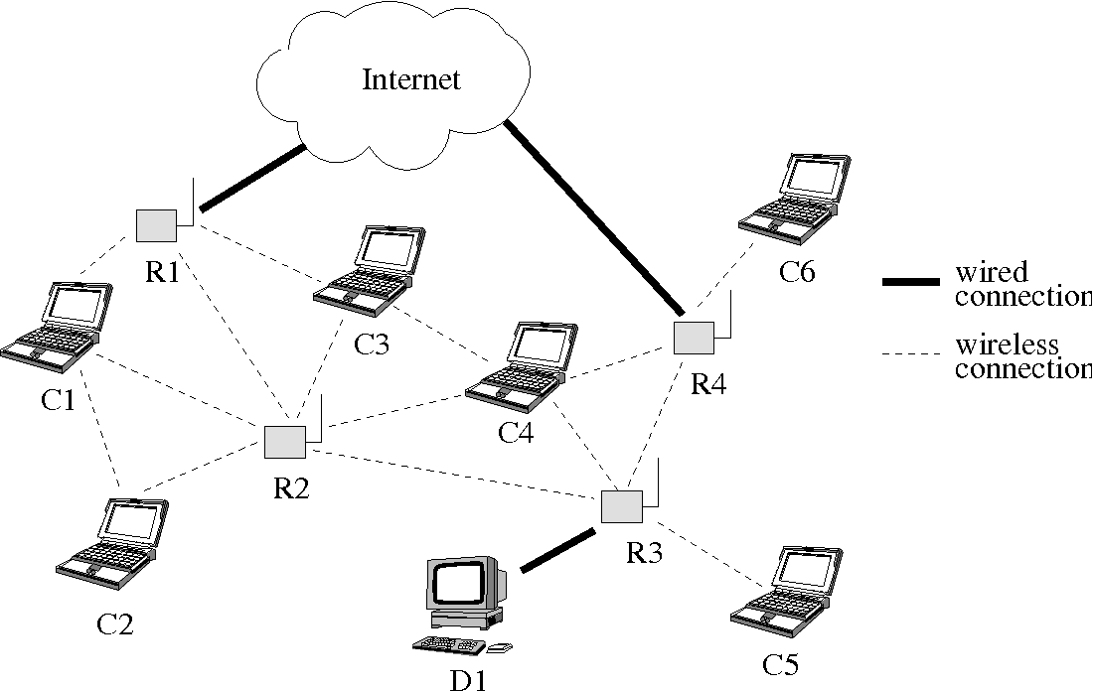
A Novel Multi-Hop Routing Protocol for D2D Communications in 5G
LITERATURE REVIEW
Rana E. Ahmed has proposed this paper Intelligent transportation frameworks are intended to give imaginative applications and administrations.
To achieve an effective utilization of available resources, reduce latency, improve data rates, and increase system capacity, D2D communication utilizes nearby communicating devices
D2D communications,
5G,
Multi-hop Routing,
Dynamic Source Routing (DSR)

Slide 4
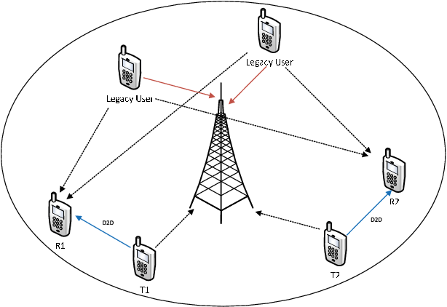
LITERATURE REVIEW Discovery Signal Design and Its Application to Peer-to-Peer Communications in OFDMA Cellular Networks
Michael. Wang, and C. Jiang has proposed this paper Intelligent transportation frameworks are intended to give imaginative applications and administrations.
Proposes a unique discovery signal as an enabler of peer-to-peer (P2P) communication which overlays a cellular network and shares its resources.
Peer-to-peer networks,
neighbor discovery signals,
OFDMA cellular networks

Slide 5
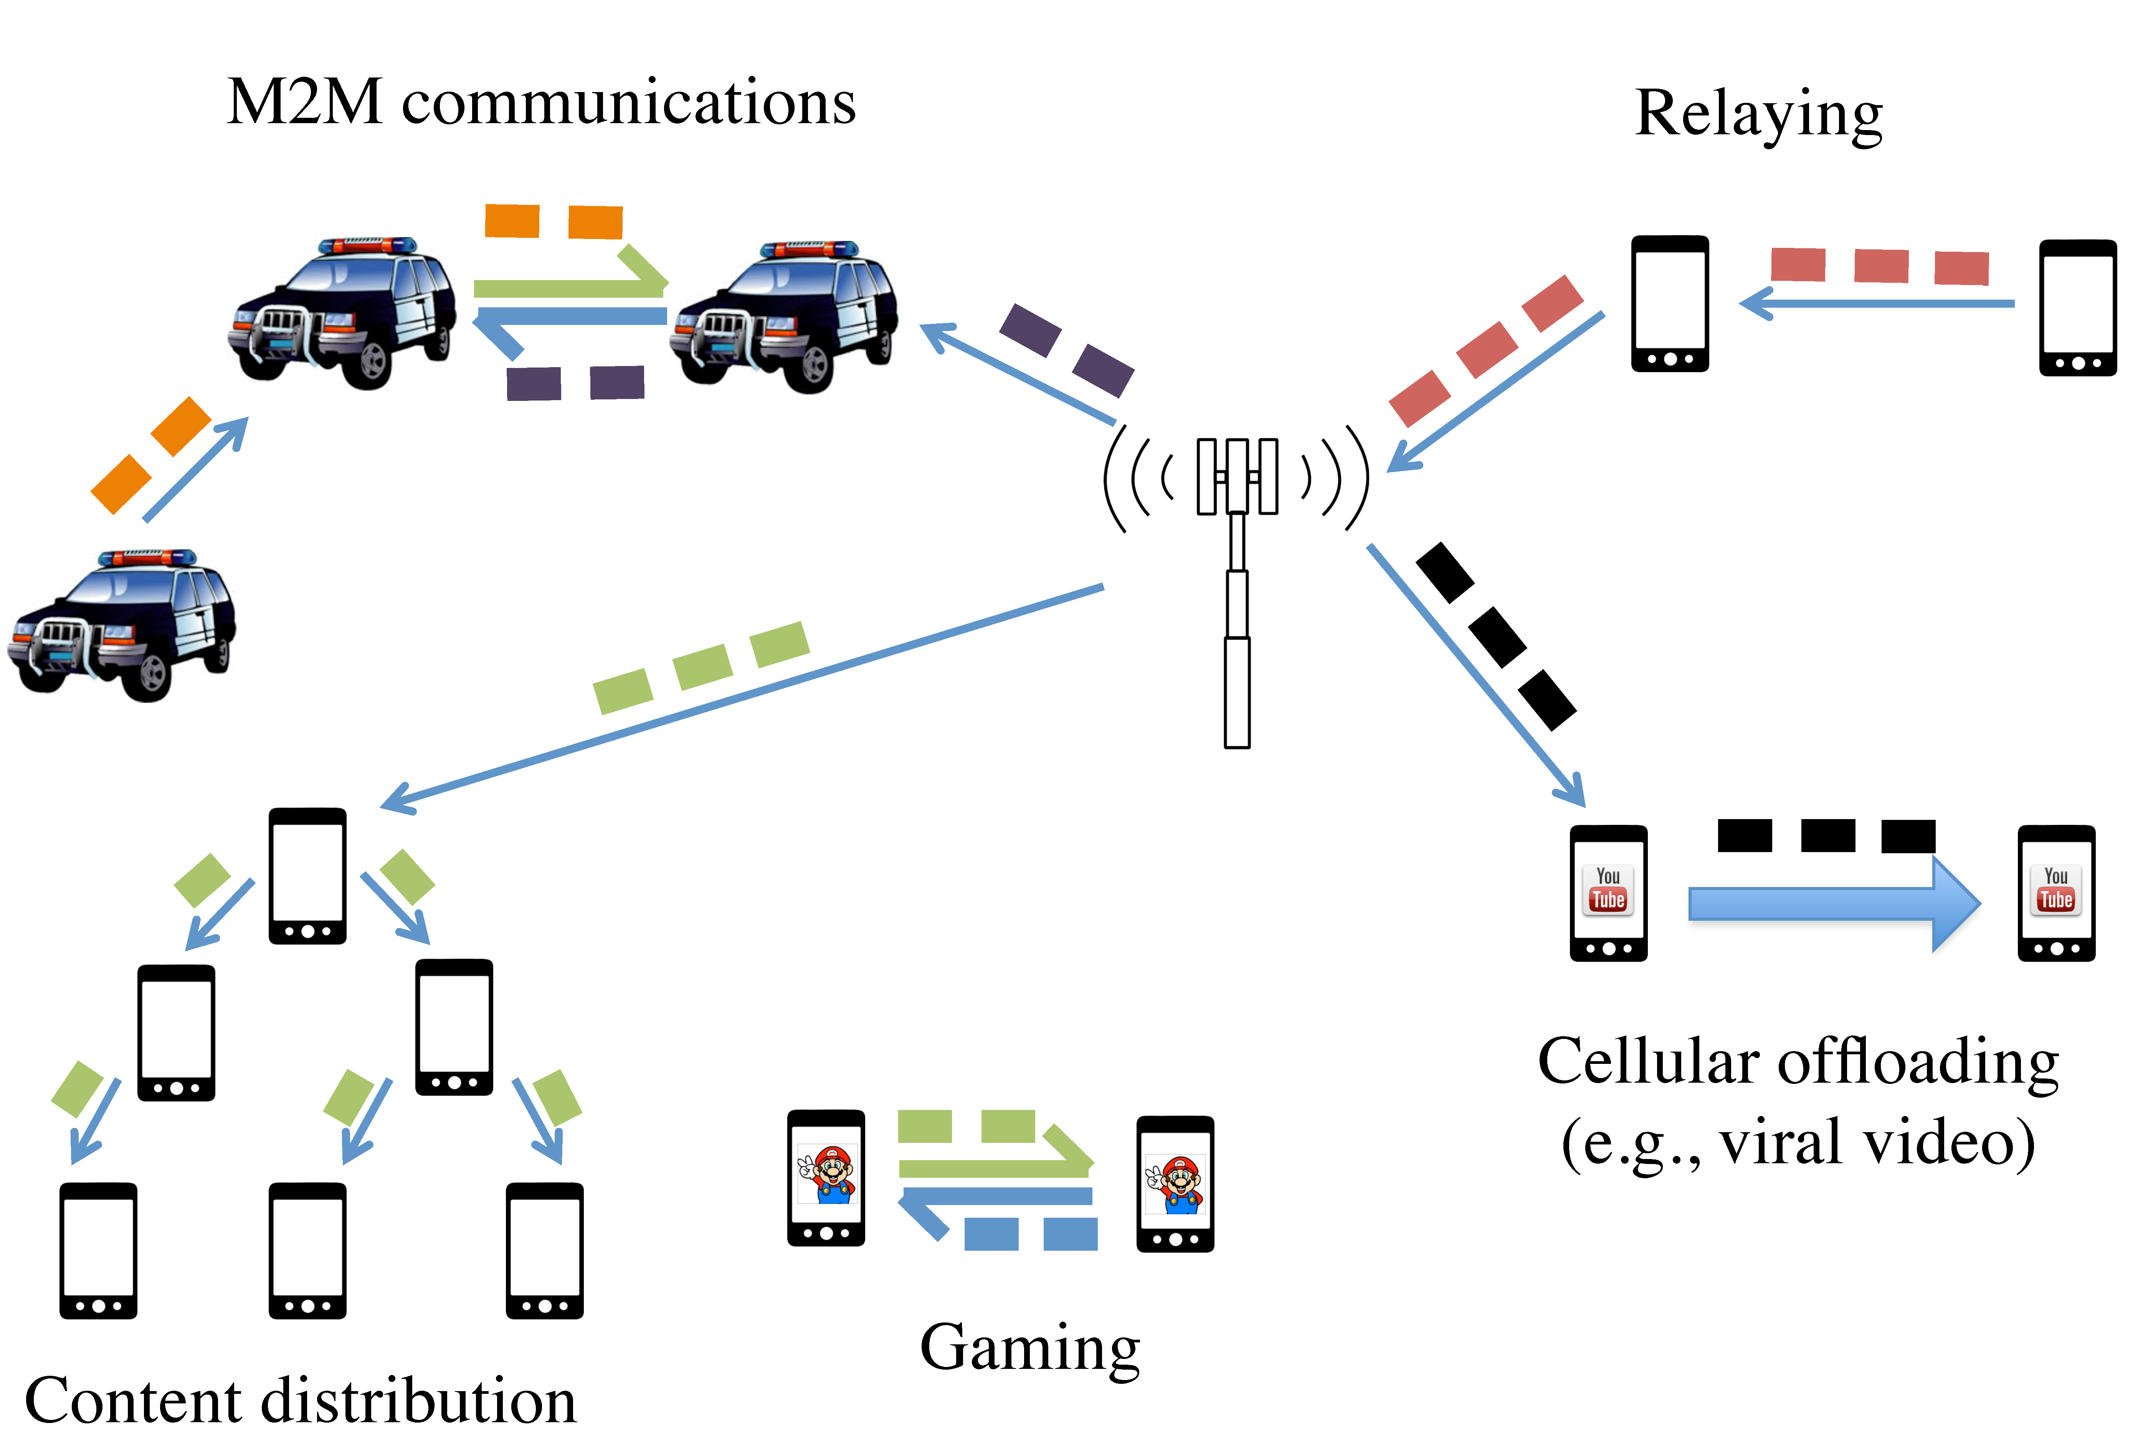
A Survey on Device-to-Device Communication in Cellular Networks
LITERATURE REVIEW
Arash Asadi, Student Member, IEEE, Qing Wang, Student Member, IEEE, and Vincenzo Mancuso, Member, IEEE has proposed this paper Intelligent transportation frameworks are intended to give imaginative applications and administrations
Device-to-Device (D2D) communication was initially proposed in cellular networks as a new paradigm to enhance network performance.
Device-to-Device communication,
Cellular networks,
LTE,
LTE-A

Slide 6
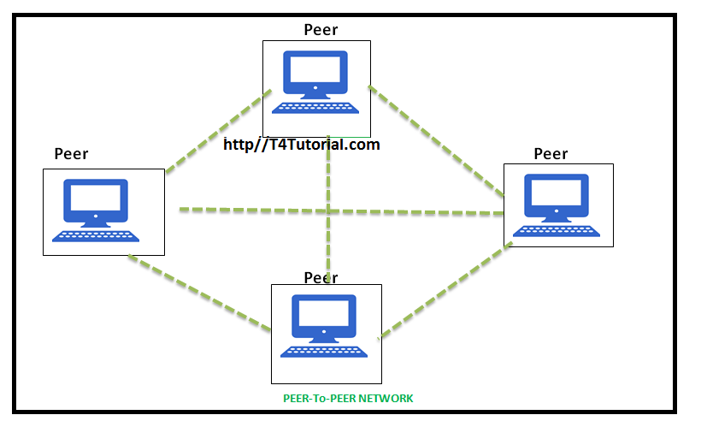
Green Random Access for Wireless Peer Discovery
LITERATURE REVIEW
Taesoo Kwon, Member, IEEE has proposed this paper Intelligent transportation frameworks are intended to give imaginative applications and administrations
This letter investigates the joint design problem of transmission probability (v) and transmit power (p) in random access-based wireless peer discovery (RA-WPD) operations, in terms of reducing the power consumption of the peers.
Peer discovery,
energy saving,
power control,
random access,
stochastic geometry,
D2D networks.

Slide 7
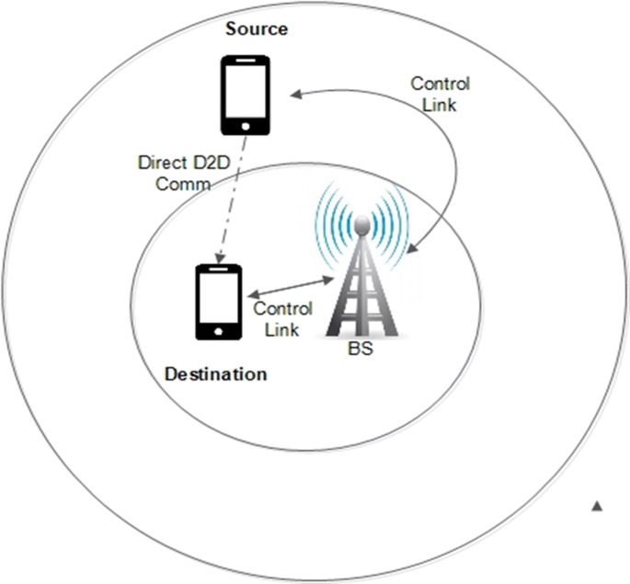
Connectivity of Cognitive Device-to-Device Communications Underlying Cellular Networks
LITERATURE REVIEW
Mohammad G. Khoshkholgh, Yan Zhang, Senior Member, IEEE, Kwang-Cheng Chen, Fellow, IEEE,Kang G. Shin, Life Fellow, IEEE, and Stein Gjessing has proposed this paper Intelligent transportation frameworks are intended to give imaginative applications and administrations
However, such device-to-device (D2D) communications create a new type of interference in cellular systems
Cellular networks,
coverage probability,
interference threshold constraint,
collision probability constraint,
percolation,

Slide 8


On Service Discovery In Mobile Social Networks: Survey And Perspectives
LITERATURE REVIEW
Mobile social networks represent a convergence between mobile communications and service-oriented paradigms, which are supported by the large availability and heterogeneity of resources and services offered by recent mobile devices.
In particular, the service-oriented nature of MSN is in the capability of sharing resources and services among devices that lie in proximity and that opportunistically interact.

Slide 9
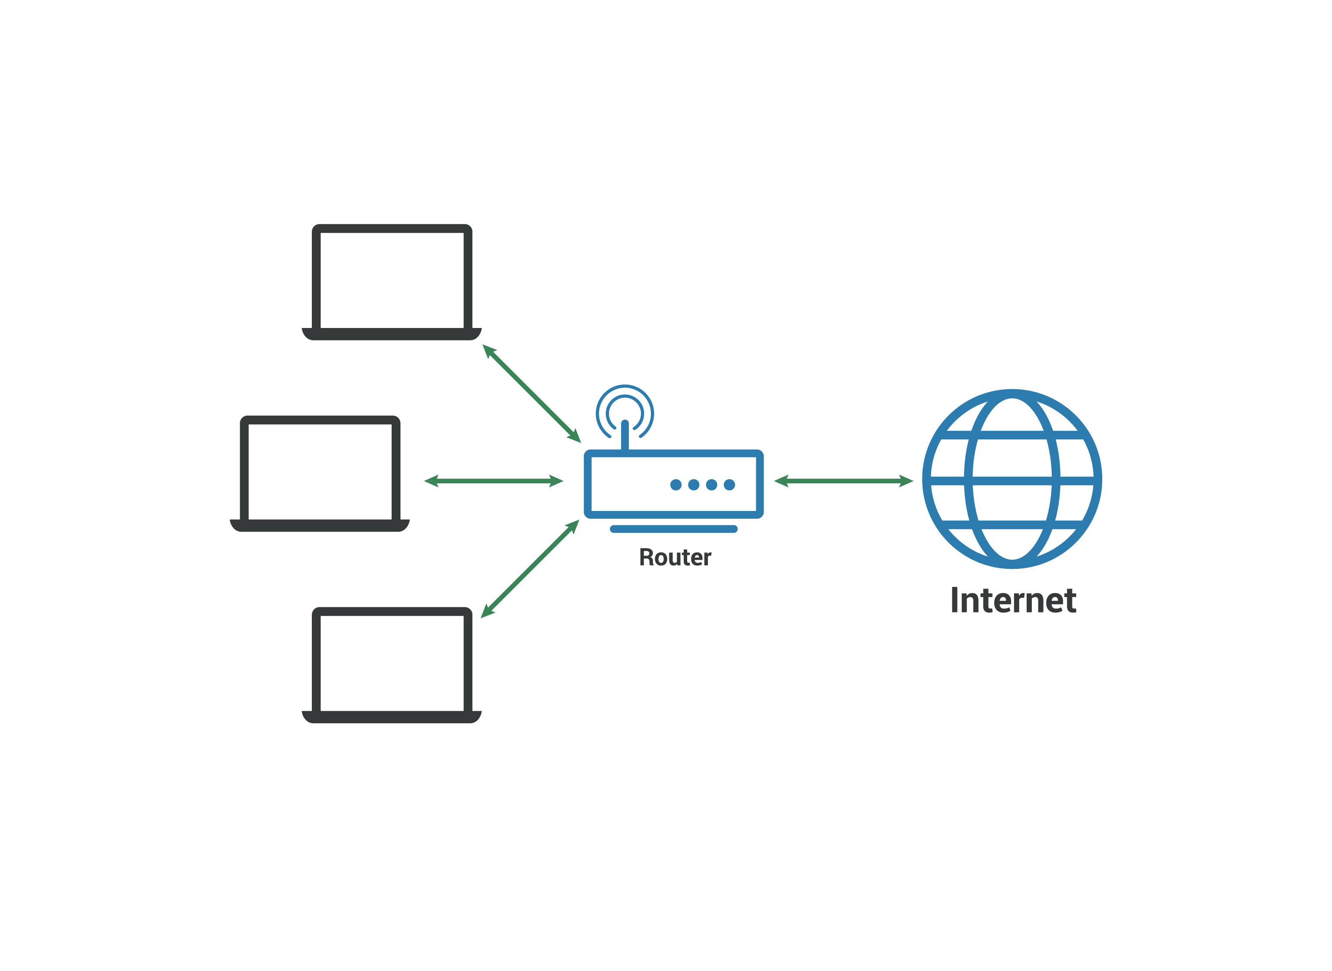
EXISTING SYSTEM
In the existing system the other methodologies like the wireless position estimation , neighbor route discovery , out band , energy efficiency , discovery latency , mobility , 5g enhanced.
This methods gave the opportunity to lead the future industrial research either in one or more categories.
Results in loss in energy and excessive time delay .

Slide 10
Drawbacks of Existing Systems
Less energy efficient
High latency
Poor Neighbor discovery
Optimal path is not efficient

Slide 11
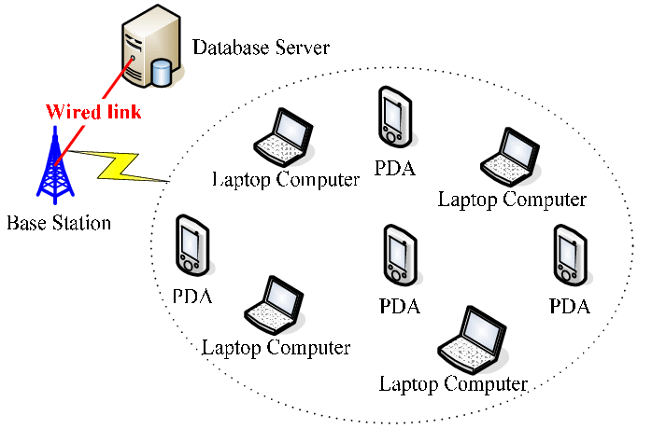
PROPOSED SYSTEM
PSO(particle swarm optimization) is used as the proposed methodology in our system .
we provide high efficiency system infrastructure with the help of PSO resulting that in band , out band , energy efficiency , discovery latency , mobility , 5g are enhanced resulting in various .
communication between the various devices are optimized so that the communication is enhanced with the high level of security.

Slide 12

Advantage of Proposed System
Low latency
Good accuracy
Minimum amount required to discovery an node

Slide 13

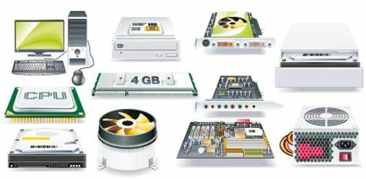
System Requirement
Hardware Requirement
Processor – Intel i3
Ram – 4 GB
Storage– 250 MB
Software Requirement
Operating System – Windows 8
Front end – Net Beans IDE 8.3
Tools – Weka Tools

Slide 14
LIST OF MODULES
Clusters Formation
Number Of Clusters And Ch-density
Clustering During Each Round For Selecting The Cluster Heads(data Sensing)
Cluster Formation Required After Each Rotation Of Cluster Head (Intra Routing And Extra Routing)
Distribution Of Cluster Heads Over The Network

Slide 15
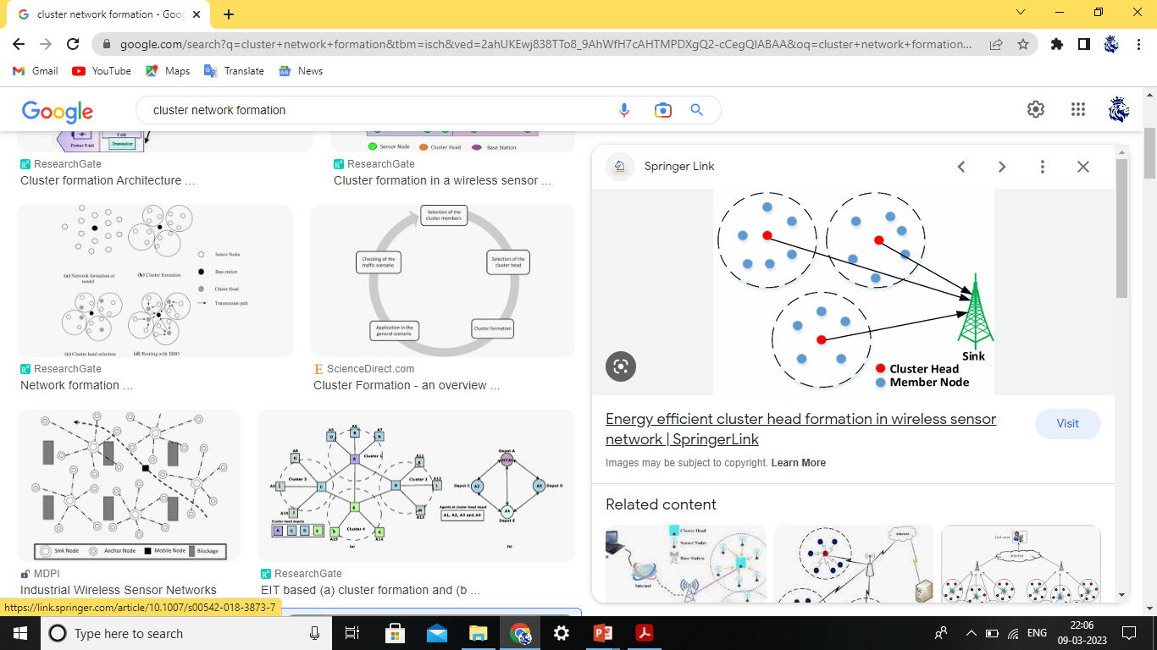
Clusters Formation
We can see that the distribution of the cluster sizes is highly uneven between the clusters: four clusters (25% of the total clusters) have a size more than double that of the other clusters.
Thus, the CHs of those large clusters may encounter traffic congestion.
It is worth noting that, because of the border effects, than nodes in the border’s vicinity.

Slide 16
Number Of Clusters And Ch-density
Distributed clustering is a robust technique used to organize ad hoc deployed wireless nodes to form a communication network.
A widely adopted in energy constrained ad hoc deployed wireless sensor networks.
The reliability is directly connected to the redundancies associated with the nodes within a cluster.
The probability distribution of the cluster area is consider to the boundary .
The node with the highest fitness to become a CH

Slide 17
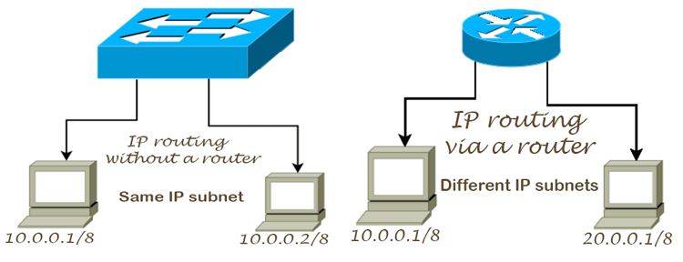
Cluster Formation Required After Each Rotation Of Cluster Head (Intra Routing And Extra Routing)
The minimum number of hops might constitute such a metric that could be used to compute a shortest path through a network.
In the intra routing the each sub nodes is connected to the internal connection with the user nodes in each and every clusters.
Exterior Gateway Protocol (EGP) is a Routing Protocol which is used to find network path information between different networks.

Slide 18

Clustering During Each Round For Selecting The Cluster Heads (data Sensing)
In this module the user node(c1,c2.,) and the normal nodes (n1,n2.,) all these nodes sense the nearest server for the device to device communication with the minimum a highest efficient .
Each user node will be connected to the each nodes which comes under the network base station.

Slide 19
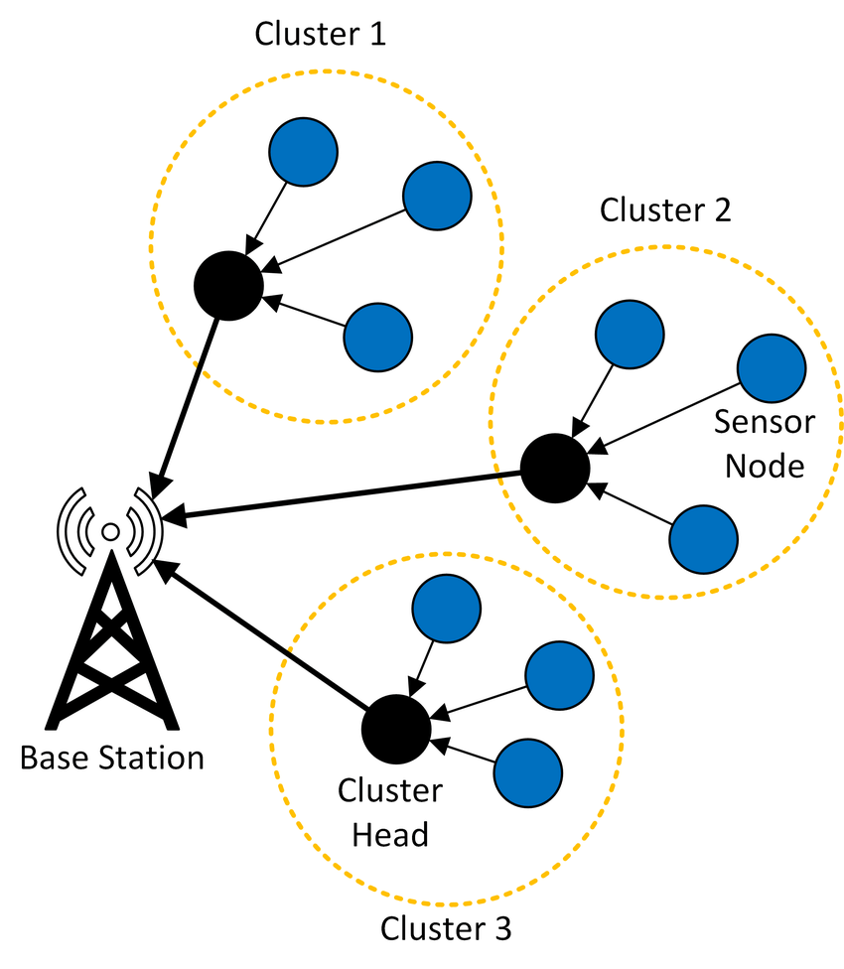
Distribution Of Cluster Heads Over The Network
The distribution of cluster heads over the network is the measurement of performance in Wireless sensor network
The performance of energy in each nodes are calculated.
For each channel the nodes and the connectivity of the base station is done efficient

Slide 20
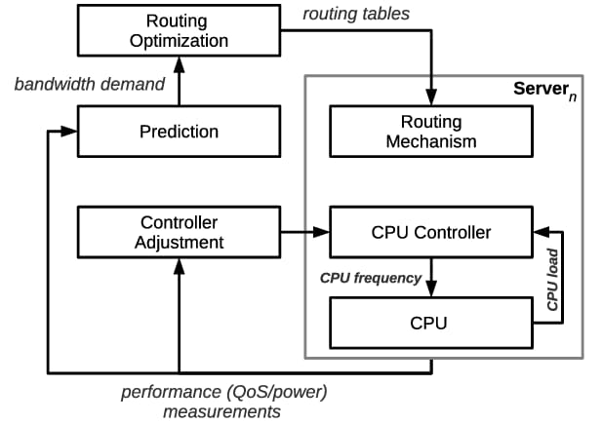
SYSTEMFLOW DIAGRAM

Slide 21
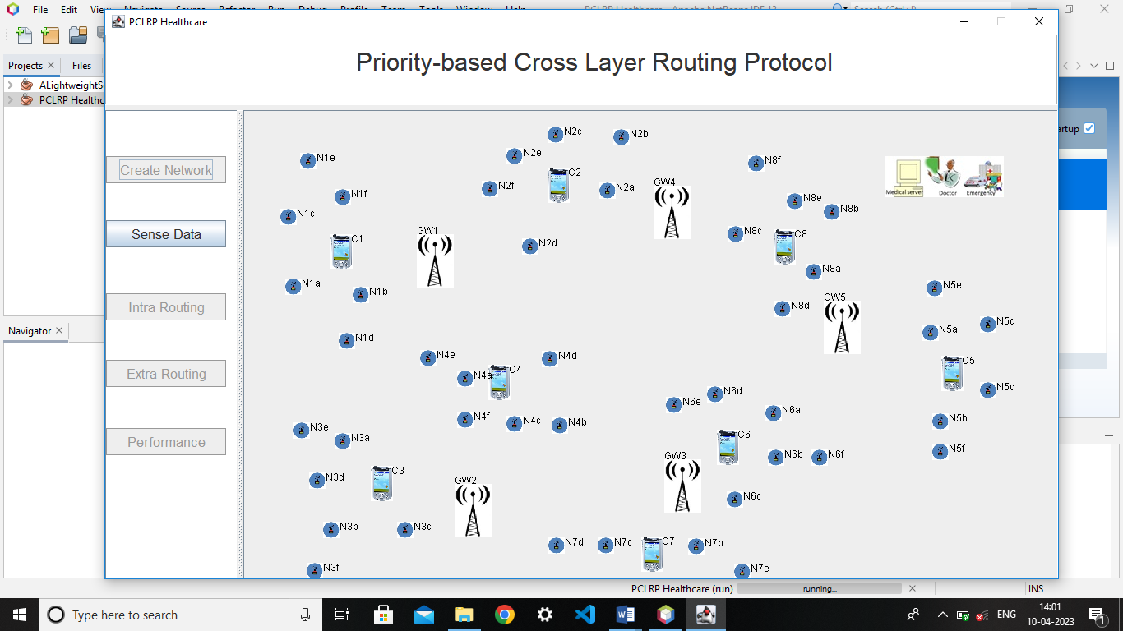
OUTPUT Creating An Network

Slide 22
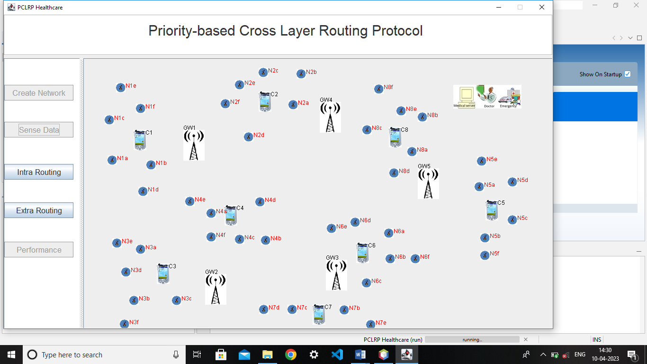
Sense Data

Slide 23
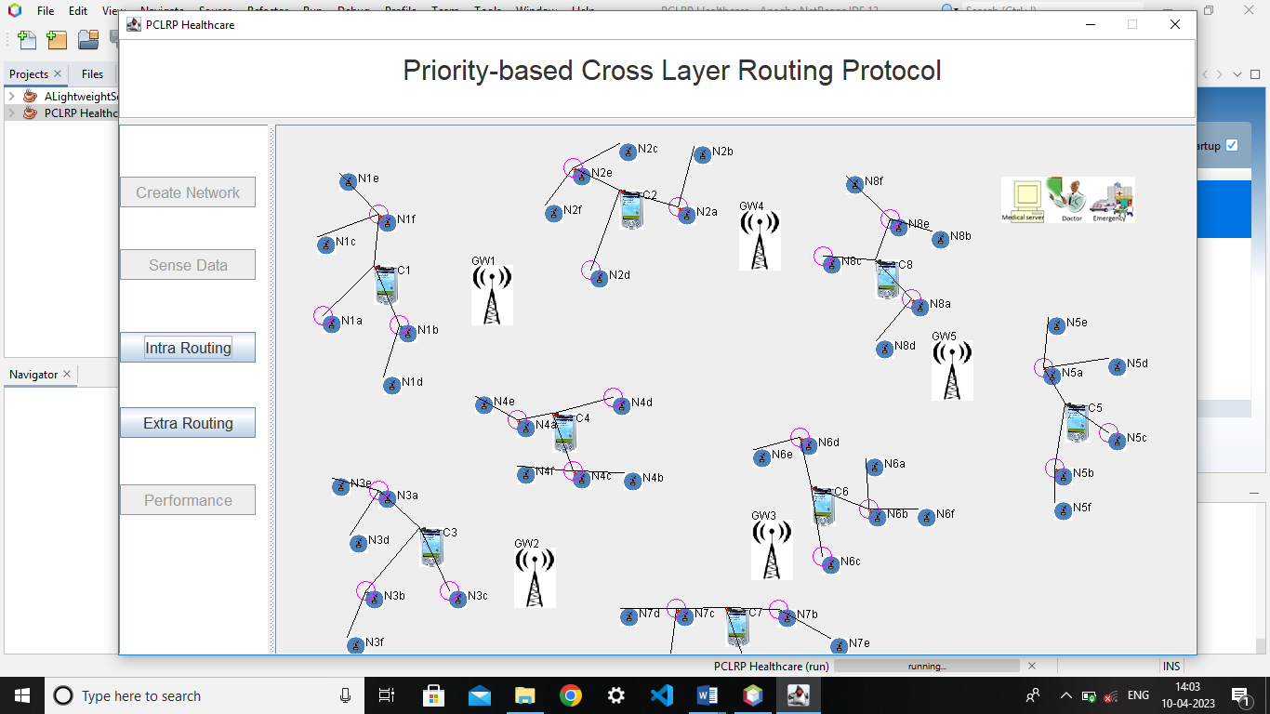
Intra Routing Protocol

Slide 24
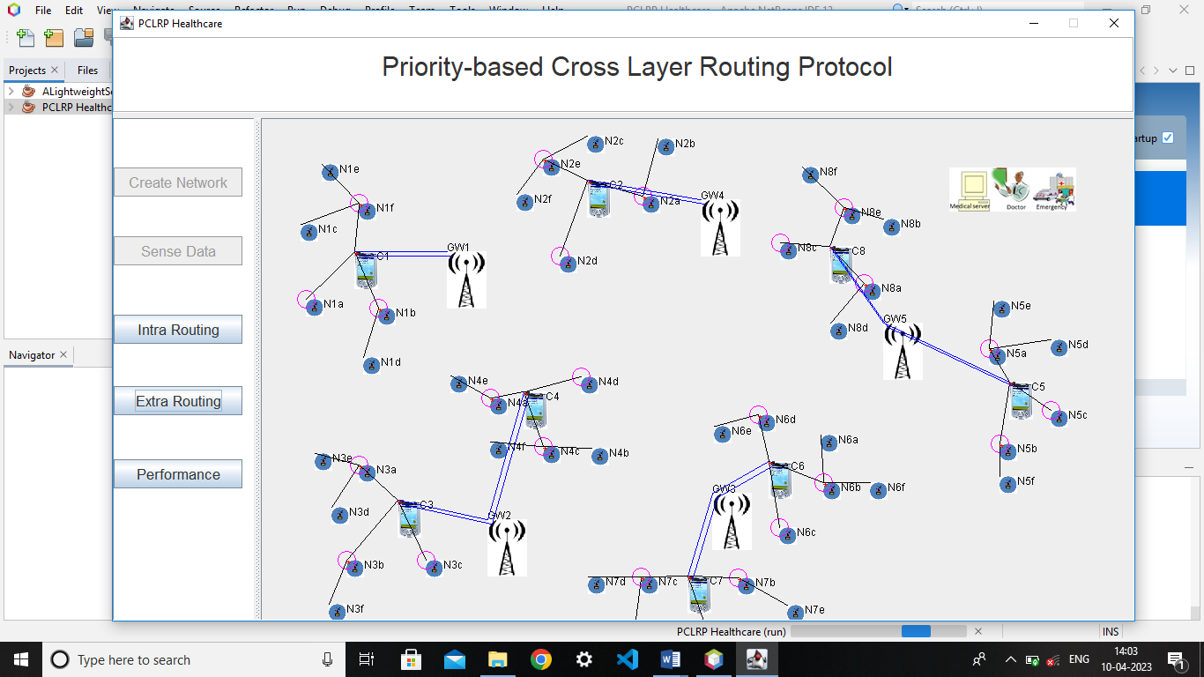
Extra Routing Protocol

Slide 25
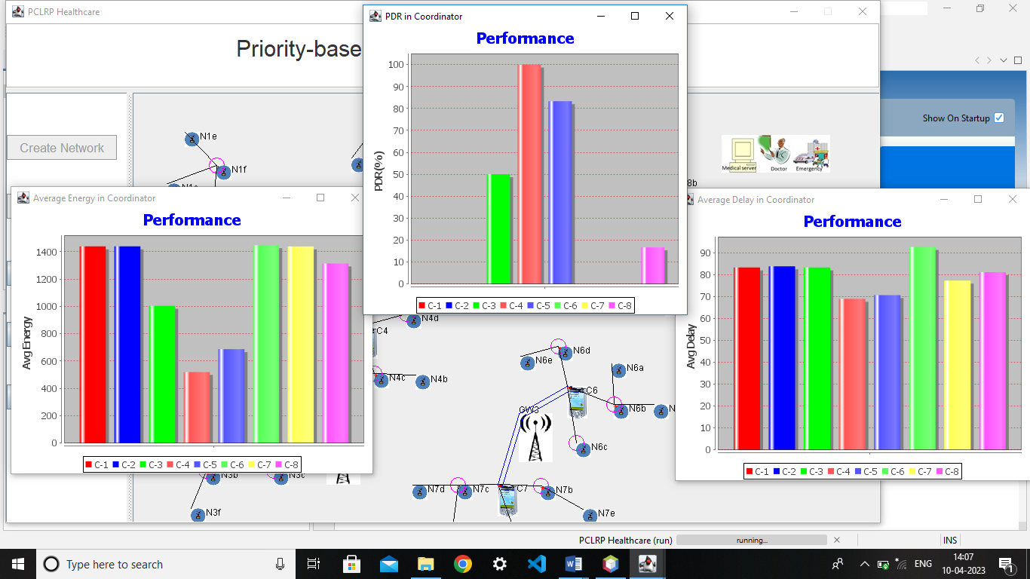
Testing Performance In Routing Protocol

Slide 26
CONCLUSION
The scenarios and taxonomy classify DD protocols, and highlight the distinctions between algorithms.
The objective of mobility aware algorithms is to exploit and understand the mobility pattern for further optimization.
Several algorithms and protocols are compared for in-band and out-band under these principles and discovery latency, energy efficiency, mobility are assessed.
The quantitative analysis are made among different DD algorithms and procedures to enhance the scope of survey article

Slide 27
REFERENCES
Andrew. S Buzzi. M,Cisco. S,”What will be 5G”? IEEE.J.SEI.Areas commun ; vol 32 ,no.6 ,pp 1065-1082 , june 2022
Chour. H , Nasser. Y, Artail. H , Kachouh. A, and A. Al-Dubai, ‘‘VANET aided D2D discovery: Delay analysis and performance,’’ IEEE Trans. Veh. Technol., vol. 66, no. 9, pp. 8059–8071, Sep. 2019
Duan. X,Liu. X, and Yaacoub.k “Wireless device connecting” IEEE Commun. Surveys Tuts., vol. 14, no. 4, pp. 833–868, 4rd Quart., 2019
Jameel. F, Hamid K, Jabeen. S,Zeadally. S, and Javed. M .A, ‘‘A survey of device-to-device communications: Research issues and challenges,’’ IEEE Commun. Surveys Tuts., vol. 20, no. 3, pp. 2133–2168, 3rd Quart., 2019
Khoshkholgh. M. G,Zhang. Y,Chen.C .Kand S. Gjessing, ‘‘Connectivity of cognitive device-to-device communications underlying cellular networks,’’ IEEE J. Sel. Areas Commun., vol. 33, no. 1, pp. 81–99, Jan. 2019.

Slide 28
Kwon. T, ‘‘Green random access for wireless peer discovery,’’ IEEE Commun. Lett., vol. 19, no. 12, pp. 183–186, Feb. 2020.
Sheng. G ,shu. F,”Peer to Peer communication”,IEE wireless Network,vol. 23, no. 1,pp. 112-119, May.2022
Wang. M “Device Discovery in Routing”, IEE Wireless Network, vol 31, no.5, pp. 112-117, Nov 2021
Yang. K. W, X. Hu. You, ‘‘Device discovery for multihop cellular networks with its application in LTE,’’ IEEE Wireless Commun., vol. 21, no. 5, pp. 24–34, Oct. 2020.
Xu. L , Zhou. K, “Networrk traffic analysis” IEEE Wireless Network, Vol. 6, no. 6,pp. 67-73,Nov 2018.

